Slide 1
Future development of the European solar market towards decentralized renewable energy generation and storage: A cross-country comparative analysis
Vassilis Stavrakas
Research Associate
Technoeconomics of Energy Systems laboratory (TEESlab),
Department of Industrial Management & Technology,
University of Piraeus (UNIPI)

Slide 2
Introduction
Decentralized future
Realistic pathway towards a low carbon power system
generating
storing
...at local level
consuming
Vision of consumers
sharing clean energy
Technological
Regulatory
challenges
Reality
Economic
Demand-Side Management (DSM) modeling
Social

Slide 3
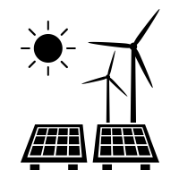
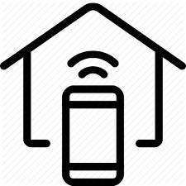
Europe’s vision for a socially fair energy transition towards 2050…
100% RES System using Storage & Demand-Response technologies
Decentralized community projects & innovative business models
System Change
Diffusion of technological breakthroughs at the residential sector
Potential also lies in energy efficiency & tackling energy poverty
Digitalization can make this transition more efficient & democratic
Smart-Grid paradigm

Slide 4
Business Models (BMs) to explore benefits of self-consumption in the power market
Our study focuses on:
Decentralized community projects & innovative business models
100% RES System using Storage & Demand-Response technologies
System Change
..on ways to couple small-scale PV with storage technologies
using this infrastructure to generate additional revenues for consumers…
Diffusion of technological breakthroughs at the residential sector
Revenue opportunity
Less reliance on subsidies
Potential also lies in energy efficiency & tackling energy poverty
Digitalization can make this transition more efficient & democratic
Such sources of revenue can counterbalance the phasing out of FiTs around Europe, so that incentives for PV adoption remain strong
Smart-Grid paradigm

Slide 5
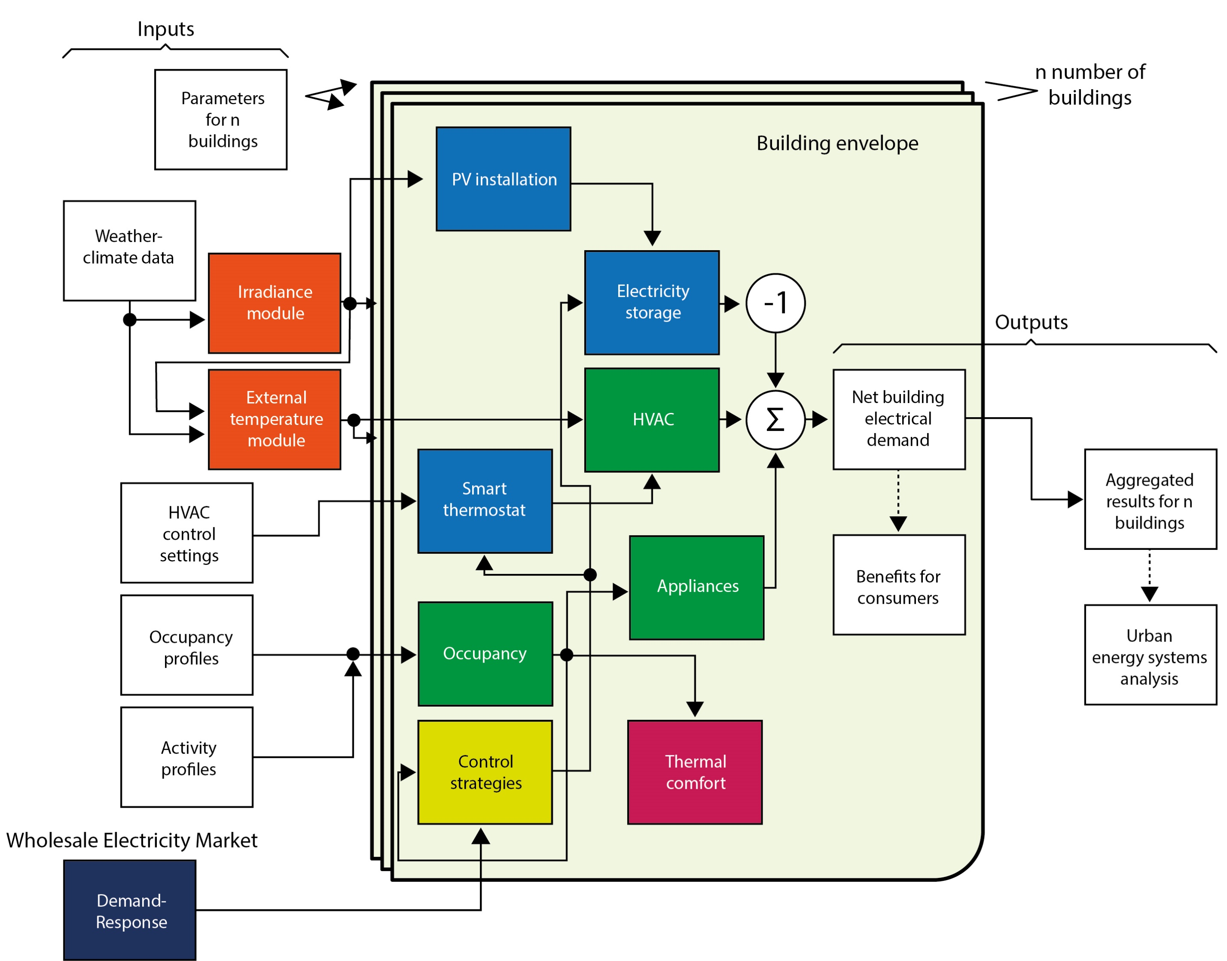
A Transdisciplinary Modeling Framework (1/4)
Modeling suite to perform quick simulations as part of an iterative participatory process aiming to provide answers to “what if” scenarios

Slide 6
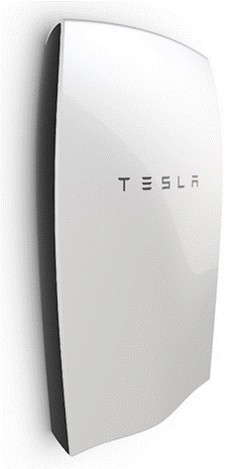
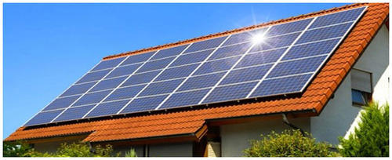
A Transdisciplinary Modeling Framework (2/4)
Business Model
Increasing the value of flexibility through provision of services to the grid
Benefits of PV self-consumption with storage at the residential sector
New small-scale
PV capacity addition
Simulation
Forward-looking projections

Slide 7
A Transdisciplinary Modeling Framework (3/4)
Inputs
Main model
Parameters for n buildings
n number of buildings
Weather climate data
PV installation
Building envelope
Irradiance module
Electricity Storage
-
Outputs
HVAC control settings
External temperature module
Smart thermostat
HVAC
Net building electrical demand
Σ
Occupancy profiles
Aggregated results for n buildings
Occupancy
Appliances
Activity profiles
Wholesale Electricity Market
Control strategies
Thermal comfort
Demand-Response

Slide 8
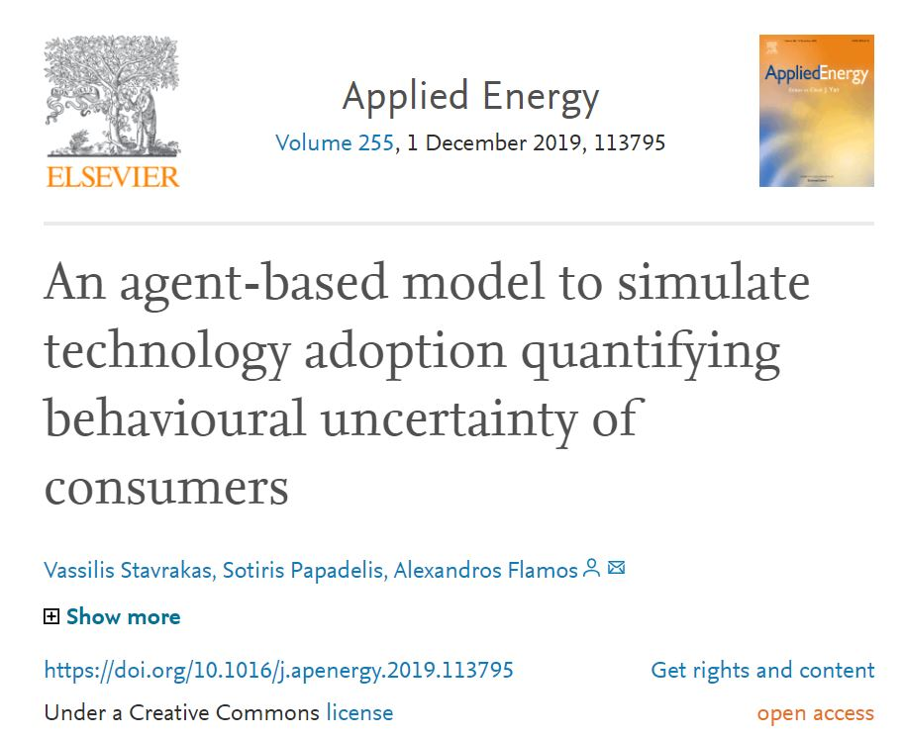
A Transdisciplinary Modeling Framework (4/4)
Agent-related parameters
Calibration based on historical market data

Slide 9
Case Studies – Geographical context
Denmark
Nordic country in Northern Europe with relatively low solar energy availability (i.e., 1000 kWh/m²)
France
Western & Central Europe - Territories with:
Diversely climate zones,
Solar energy availability:
1,000 kWh/m² (North)
1,700 kWh/m² (South)
Greece
Southern Europe - Largest coastline in Europe - electricity interconnection remains a continuous challenge
Diverse geographical landscape & high solar irradiation levels

Slide 10
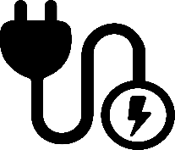
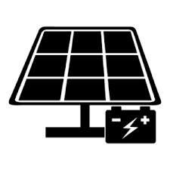
Case Studies – Policy background
2030 short-term target: 50% RES production (700 MWp of PV power installed)
2050 long-term target: 100% RES system (1,500 MWp of PV power installed)
Net-metering scheme
Efforts to support self-consumption
PV regulatory framework (at present):
2030 short-term target: 33 GWp of PV power installed
1st Model: FiTs without the possibility of self-consumption
PV installations
2nd Model: Self-consumption with investment grant & fixed FiTs for excess electricity fed into the grid
2030 short-term target: 6,900 MWp of PV power installed
Net-metering scheme
Efforts to support self-consumption
PV regulatory framework (at present):

Slide 11
Case Studies – Scenario analysis (1/4)
Business-As-Usual (“SC1”)
Weather Data
Copenhagen
School-aged child
(6-11 years old)
Adolescent
(12-18 years old)
Paris
Nuclear (conjugal) family:
2 working parents & 2 children
Athens

Slide 12
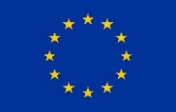
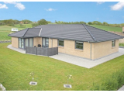
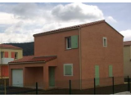
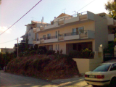
Case Studies – Scenario analysis (2/4)
Business-As-Usual (“SC1”)
Building Typologies
TABULA
webtool
Single Family House
2007 -2010
Reference Floor Area: 145 m²
Single Family House
2006 -2012
Reference Floor Area: 105 m²
Single Family House
2001 -2010
Reference Floor Area: 115 m²

Slide 13
Case Studies – Scenario analysis (3/4)
II. Flexibility through provision of services to the grid (“SC2”)
Policy scheme:
- 25% subsidy of storage
School-aged child
(6-11 years old)
Adolescent
(12-18 years old)
Nominal power
1 kWp
Expected lifetime
3,000 equivalent full cycles
Nuclear (conjugal) family:
2 working parents & 2 children
Initial investment cost 800 €/kWh

Slide 14
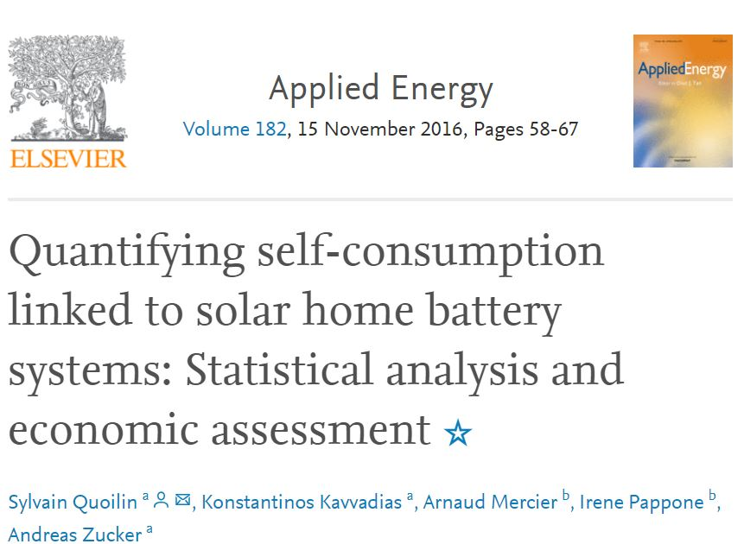
Case Studies – Scenario analysis (4/4)
II. Flexibility through provision of services to the grid (“SC2”)
Storage dispatch model
Sizing of 1-to-1 for storage capacity to PV peak power
Optimization algorithm:
Storage capacity dispatched in an optimum way to maximize self-consumption

Slide 15
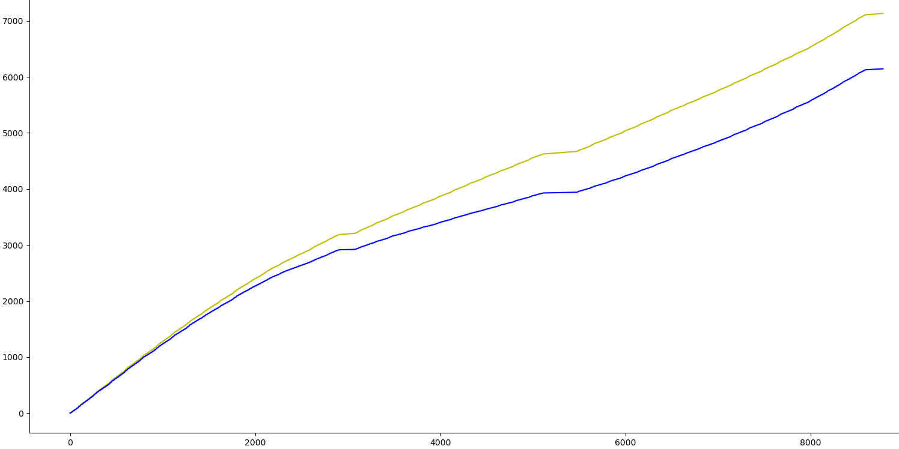
Results – Benefits of PV self-consumption with storage for consumers in Denmark
988.11 kWh
Energy Consumption (kWh/yr)
SC1
13.85%
SC2
Time (hours)

Slide 16
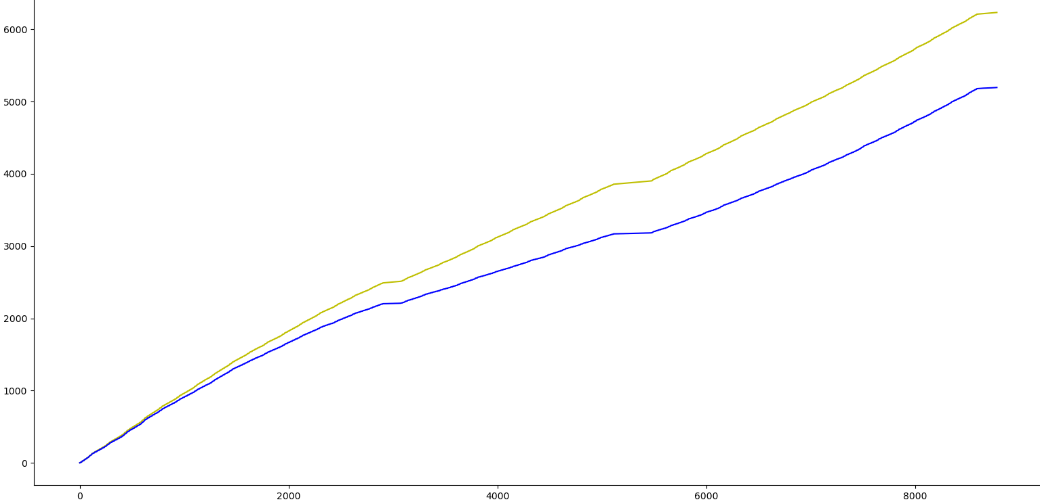
Results – Benefits of PV self-consumption with storage for consumers in France
1,038.34 kWh
Energy Consumption (kWh/yr)
SC1
16.66%
SC2
Time (hours)

Slide 17
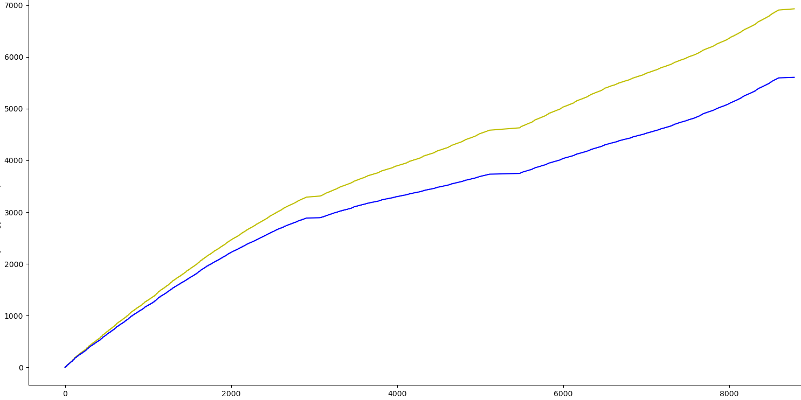
Results – Benefits of PV self-consumption with storage for consumers in Greece
1,324.42 kWh
Energy Consumption (kWh/yr)
SC1
20.11%
SC2
Time (hours)

Slide 18
Results – Comparative analysis
Greece
France
Denmark
Higher solar irradiation levels
Indicative PV & storage Cost Data, as obtained from the scientific literature & technical reports
Energy Savings as derived from the model

Slide 19
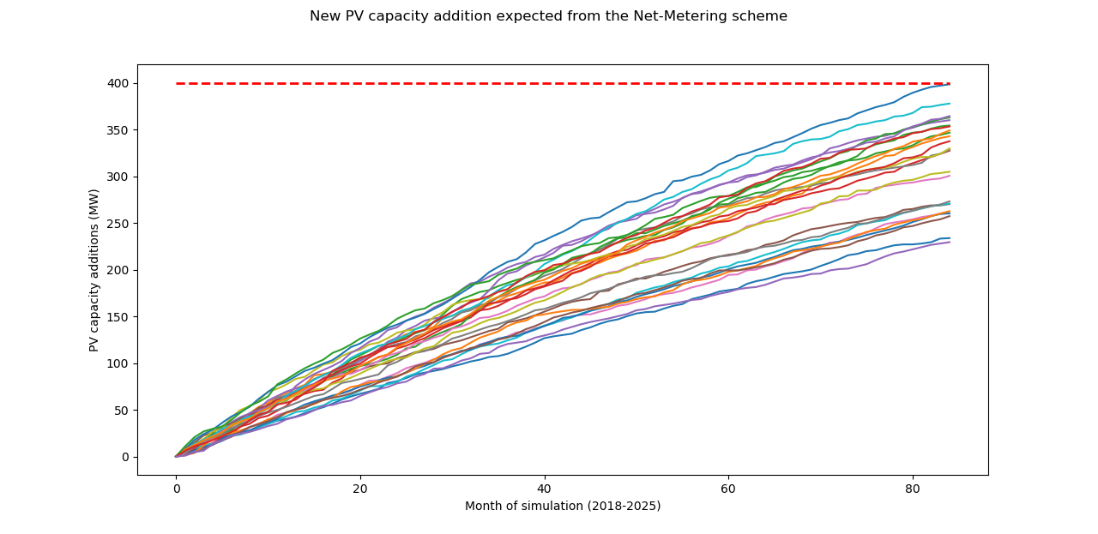
Results – Further adoption of small-scale PV towards 2030
25 different realistic
behavioral profiles of consumers
Willing
investors
25 adoption scenarios
Risk-averse
investors

Slide 20
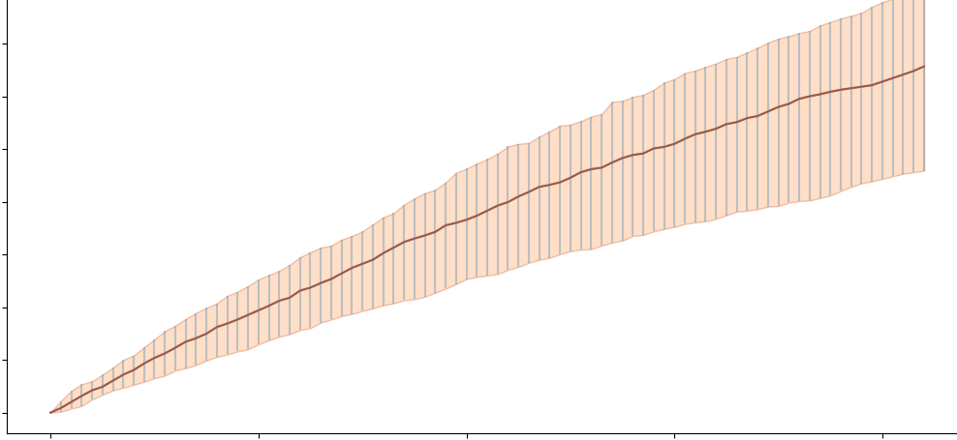
Results – Further adoption of small-scale PV towards 2030
Quantifying adoption uncertainty
Variance
of outcomes
Willing
investors
Risk-averse
investors
mean value

Slide 21
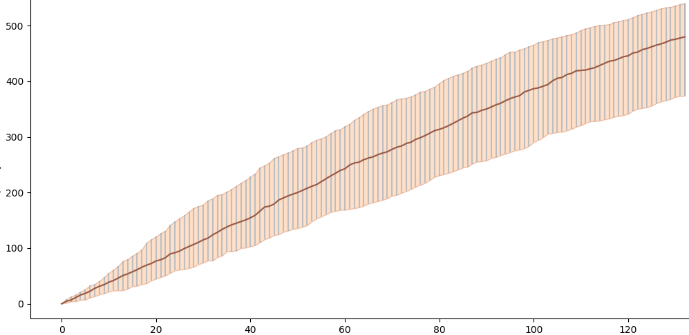
Results – Further adoption of small-scale PV in Denmark towards 2030
Average expected PV capacity addition
480 MW
PV Capacity (MW)
2020 - 2030

Slide 22
Results – Further adoption of small-scale PV in Denmark towards 2030
Quantification of uncertainty
PV Capacity (MW)
170 MW
2020 - 2030

Slide 23
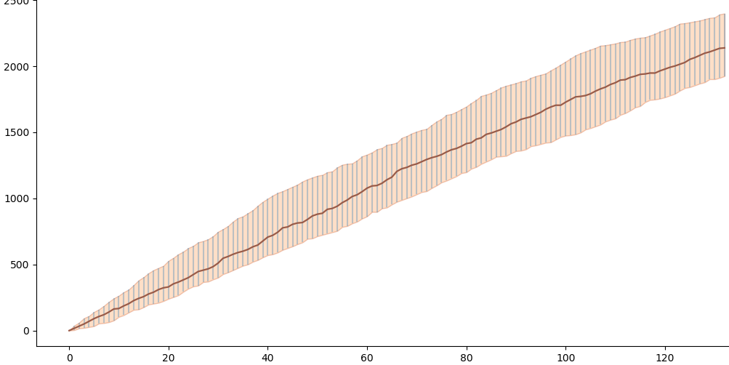
Results – Further adoption of small-scale PV in France towards 2030
Average expected PV capacity addition
2,150 MW
PV Capacity (MW)
2020 - 2030

Slide 24
Results – Further adoption of small-scale PV in France towards 2030
Quantification of uncertainty
PV Capacity (MW)
500 MW
2020 - 2030

Slide 25
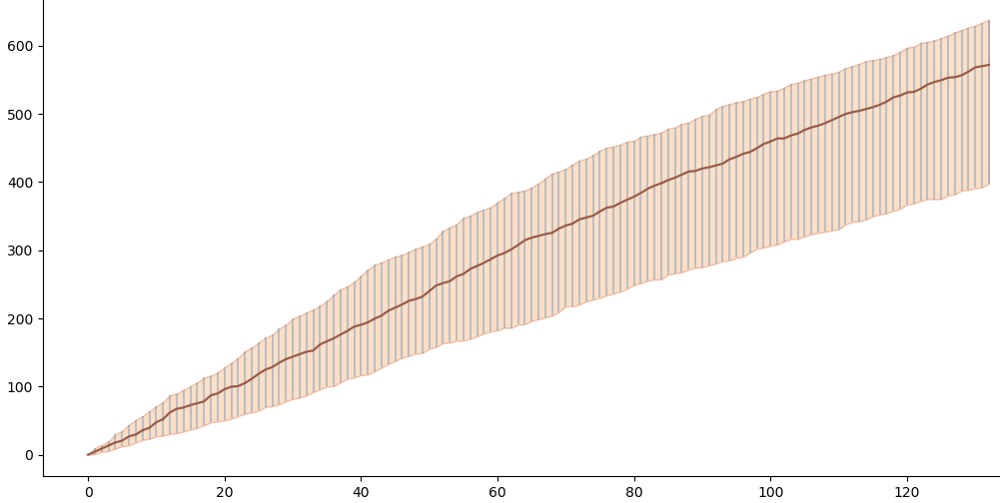
Results – Further adoption of small-scale PV in Greece towards 2030
Average expected PV capacity addition
550 MW
PV Capacity (MW)
2020 - 2030

Slide 26
Results – Further adoption of small-scale PV in Greece towards 2030
Quantification of uncertainty
PV Capacity (MW)
230 MW
2020 - 2030

Slide 27
Results – Further adoption of small-scale PV in Greece towards 2030
Average scenario (probable/realistic)
very close to the more optimistic one
Willing
investors
PV Capacity (MW)
2020 - 2030

Slide 28
Conclusions & Implications for policy
Denmark
Results are very encouraging, demonstrating the country’s high potential for a switch to a more decentralized electricity system
Public support of PV self-consumption with storage through an initial subsidy (25%) will lead to economic viability
towards the National targets of 2030
A switch to individual PV self-consumption with storage
seems reasonable and viable
A low storage subsidy (e.g., 25%) is enough for consumers to perceive the profitability of their investment

Slide 29
Conclusions & Implications for policy
France
France could be one of the front liners towards a European decentralised electricity system
Public support of PV self-consumption with storage through an initial subsidy (25%) will lead to economic viability
towards the National targets of 2030
Existing provisions that introduce PV storage systems & individual self-consumption could become economically viable
A low storage subsidy (e.g., 25%) is enough for consumers to perceive the profitability of their investment

Slide 30
Conclusions & Implications for policy
Greece
2030 National targets of small-scale PV are estimated at 620 MW → the success of a self-consumption scheme seems probable
A low storage subsidy (e.g., 25%) may not be enough to boost the further diffusion of small-scale PV
Higher levels of subsidization seem rather infeasible owing to implications of the economic recession of the past decade
National policy planning should focus on new & sustainable business models that will prove the economic viability of PV self-consumption with storage

Slide 31
Further Research: Need for Adaptive Policy Pathways … (1/3)
So …
… What should we do ???
Especially striving towards National RES Targets of
2030 & 2050

Slide 32
Further Research: Need for Adaptive Policy Pathways … (2/3)
Considering uncertainty…
Need for Adaptive Policy Pathways…
…visualizing policy adaptation maps, showing alternative pathways leading to desired policy outcomes
…incorporating multiple stakeholders’ perspectives into modelling scenarios

Slide 33
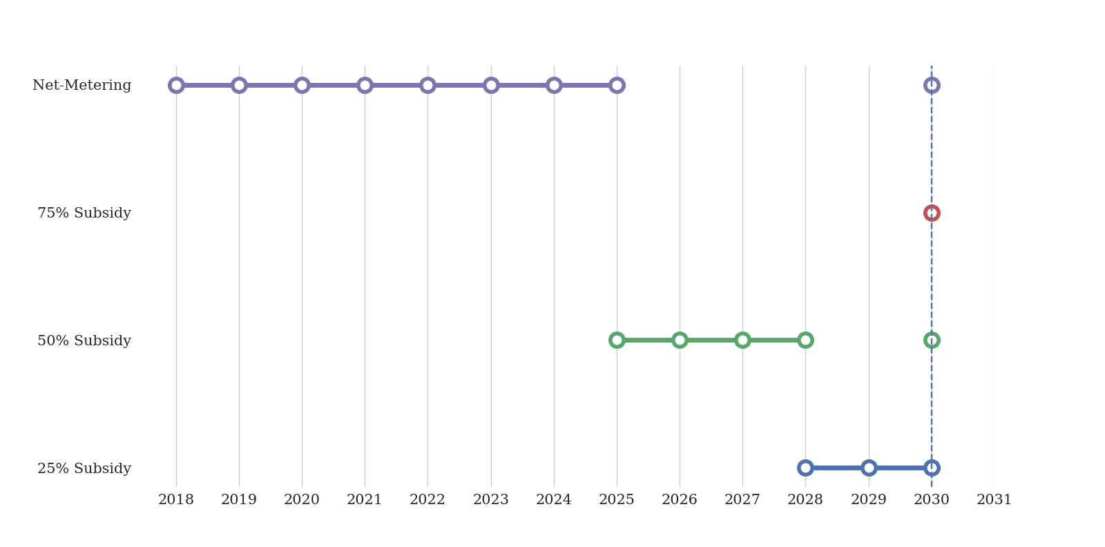
Further Research: Need for Adaptive Policy Pathways … (3/3)
Indicative example…
The ratio between large- and small-scale installations is assumed 5:1
… towards National PV targets of 2030
Net-Metering
Subsidy 75%
Current situation
Subsidy 50%
Subsidy 25%
2020
2025
2030

Slide 34
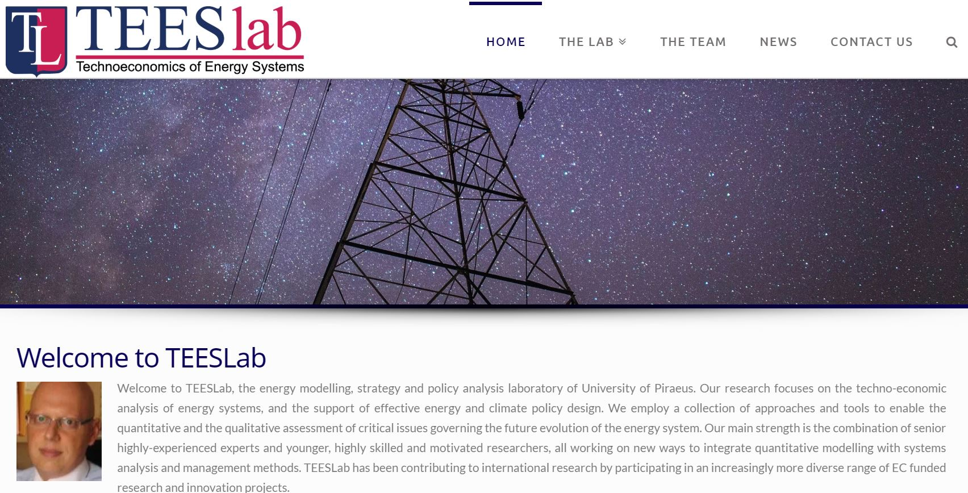
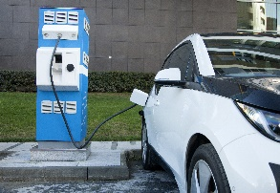
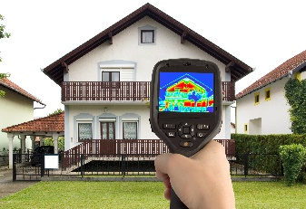
For more information…
TEESlab, the energy modelling, strategy and policy analysis laboratory of University of Piraeus (UNIPI)
Find more about us…
Visit our Website:
https://teeslab.unipi.gr/
Contact us by e-mail:
teeslab@unipi.gr
Find us in LinkedIn:
www.linkedin.com/groups/12070918/
It’s all about TEEMwork !

Slide 35
Thank you !
Vassilis Stavrakas vasta@unipi.gr

