Slide 1
Exploring the impact of Demand-Response actions on thermal comfort and energy costs in the residential sector in Greece
Assoc. Professor Dr. Alexandros Flamos
Technoeconomics of Energy Systems laboratory (TEESlab),
Department of Industrial Management & Technology,
University of Piraeus (UNIPI)

Slide 2
Decarbonization of the European building sector towards 2050…
100% RES System using Storage & Demand-Response technologies
Decentralized community projects & innovative business models
System Change
Diffusion of technological breakthroughs at the residential sector
Digitalization can make this transition more efficient & democratic
Potential also lies in energy efficiency & tackling energy poverty
Smart-Grid paradigm

Slide 3
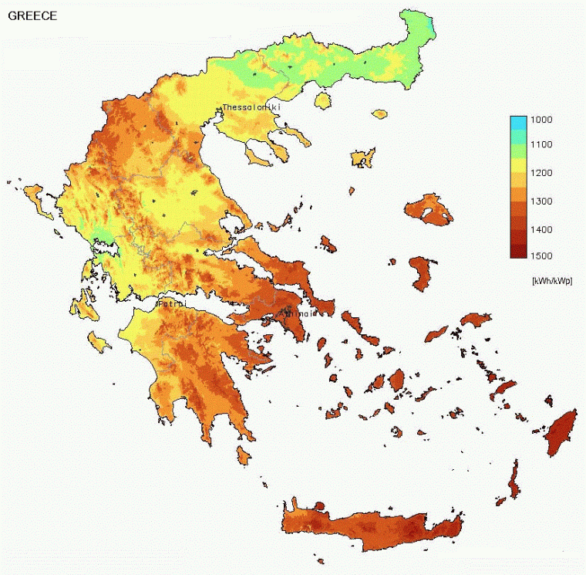
Towards the decarbonization of the Greek building sector…
Building sector has significant room for decarbonisation
Six out of ten buildings have been constructed before 1980
25-30% of the final energy is consumed at the residential sector
Need of immediate renovations
Demand-Response actions
Improved demand-side management (DSM)
Demand-Side Management (DSM) modeling

Slide 4
Why a new model ?
Outputs at a high resolution (1 minute)
Occupant behavior & determination of end-use qualities
Linking to other models & easily re-used
Modular structure
DSM modeling
Bottom-up structure
Seasonal variability to reflect the changing level of demand between winter & summer
Linking to economic development & technological breakthrough
Practical load control strategies that will allow price-based DR signals

Slide 5
Dynamic high-Resolution dEmand-sidE Management model (1/2)
Outputs at a high resolution (1 minute)
Occupant behavior & determination of end-use qualities
Linking to other models & easily re-used
Modular structure
DSM modeling
Bottom-up structure
Seasonal variability to reflect the changing level of demand between winter & summer
Linking to economic development & technological breakthrough
Practical load control strategies that will allow price-based DR signals

Slide 6
Dynamic high-Resolution dEmand-sidE Management model (2/2)
object-oriented programming
Horizon 2020
DYMOLA
equation-based system modeling
dynamic simulation environment

Slide 7
Overall architecture
Main model
Inputs
Parameters for n buildings
n number of buildings
Weather climate data
PV installation
Building envelope
Irradiance module
Electricity Storage
-
Outputs
HVAC control settings
External temperature module
Smart thermostat
HVAC
Net building electrical demand
Σ
Occupancy profiles
Aggregated results for n buildings
Occupancy
Appliances
Activity profiles
Wholesale Electricity Market
Control strategies
Thermal comfort
Demand-Response

Slide 8
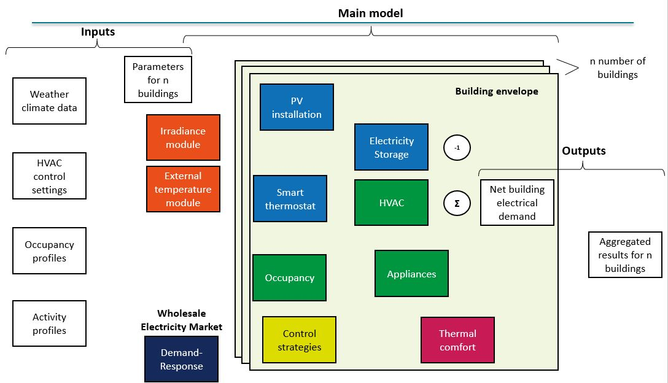
Novelty (1/2)
main principles of component- & modular-based system modeling approach
Modular structure
interdependence of decisions within modules
independence of decisions between modules
hierarchical dependence of modules on components embodying standards & design rules

Slide 9
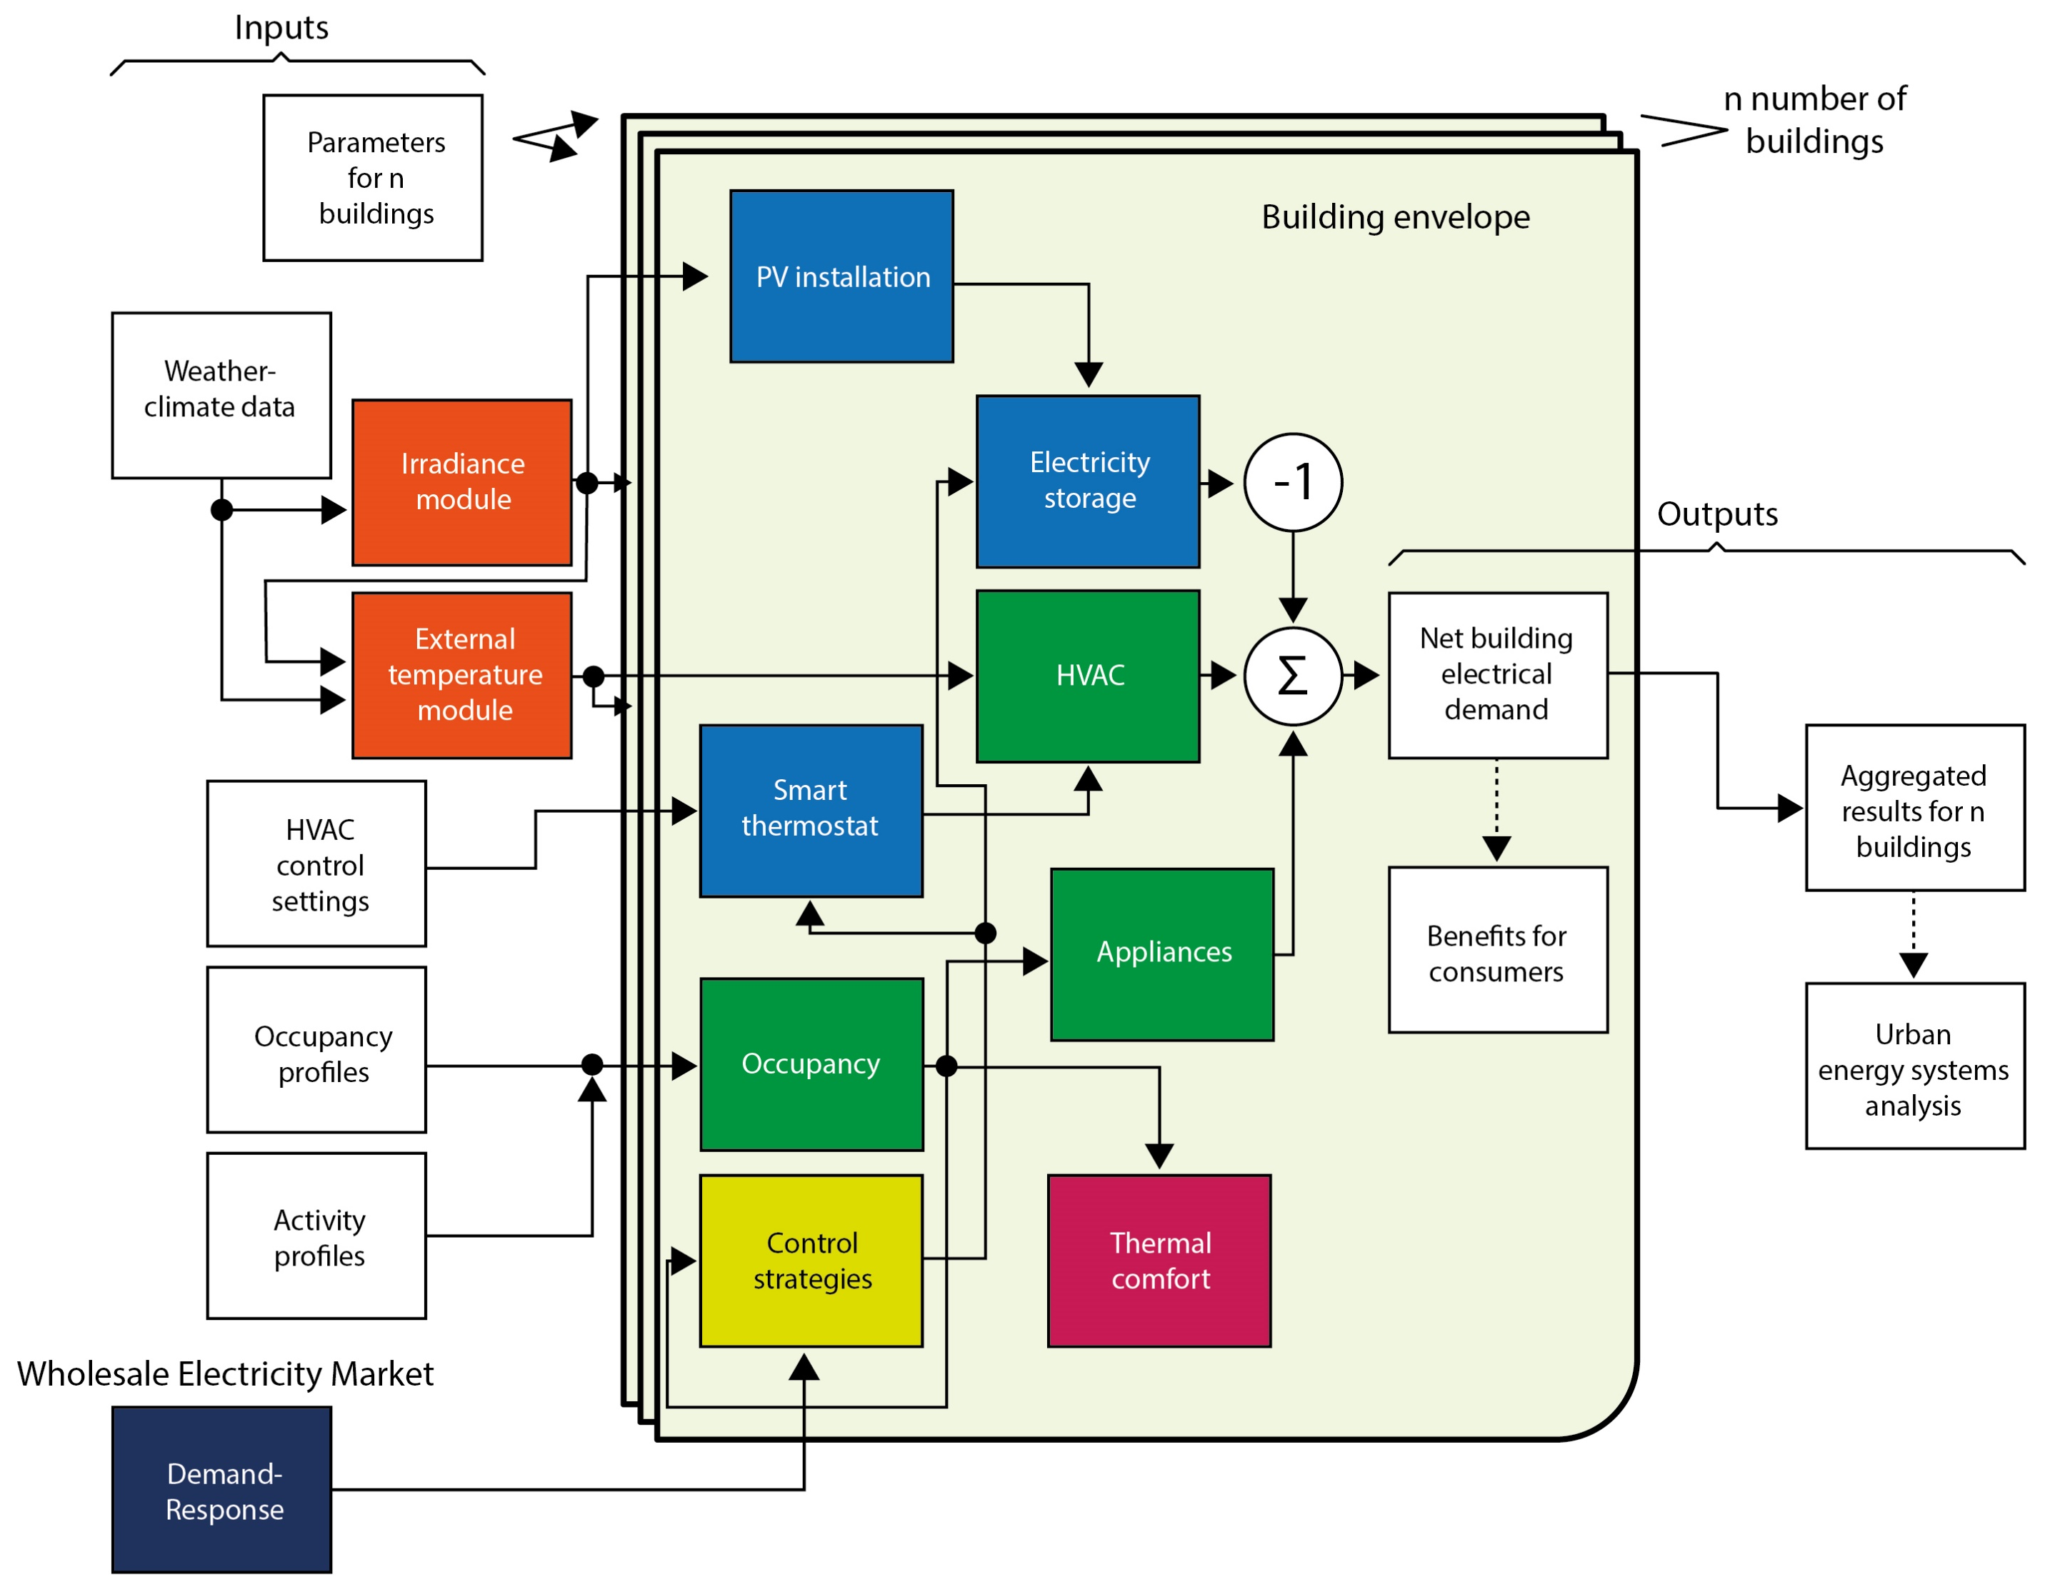
Novelty (2/2)
Incremental modeling:
sub-models in multiple levels
Control capabilities: managing the complexity of large systems
Realistic representations of dynamic systems
Fast development & simulations: computational efficiency
Wide range of applications on Europe’s energy transition towards 2050

Slide 10
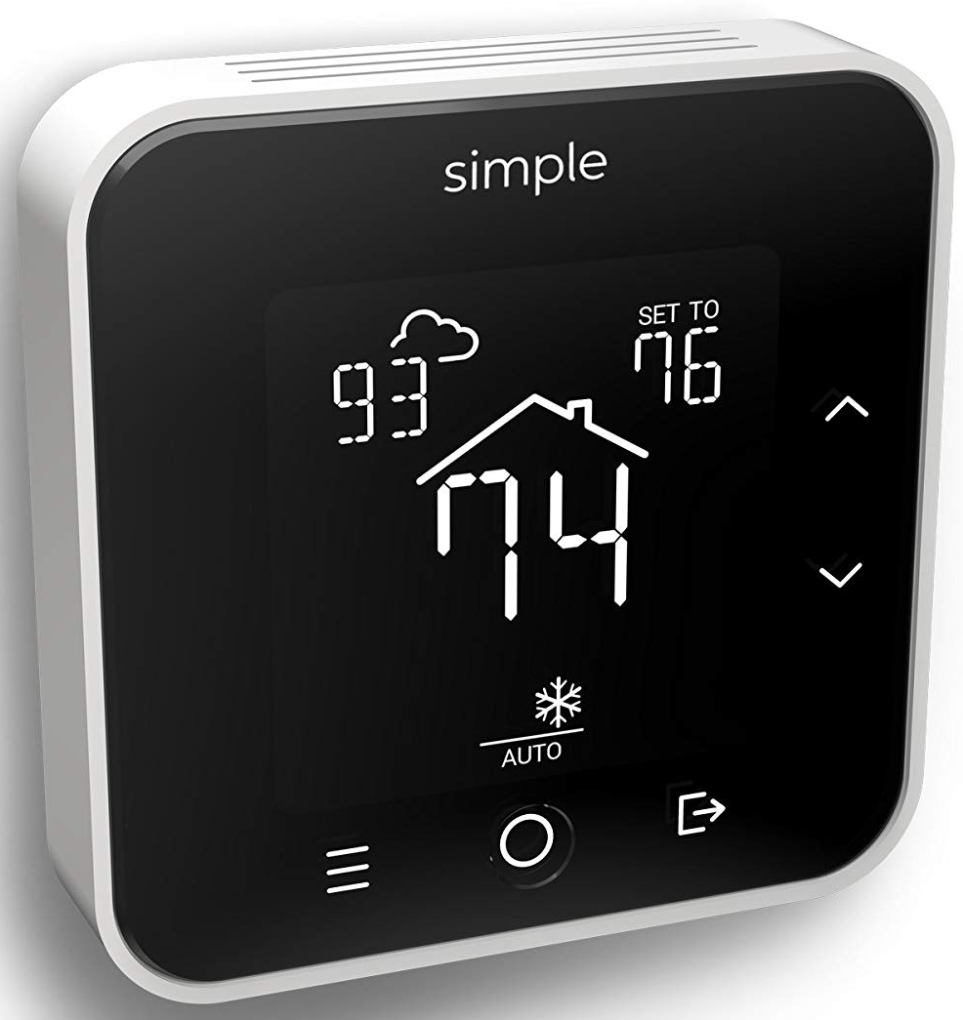
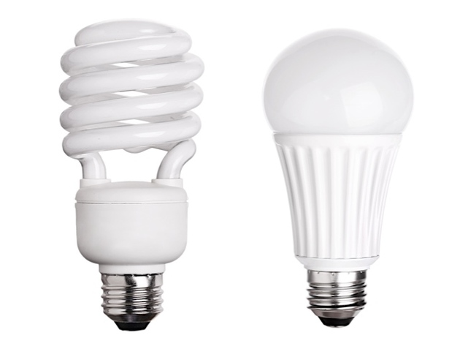
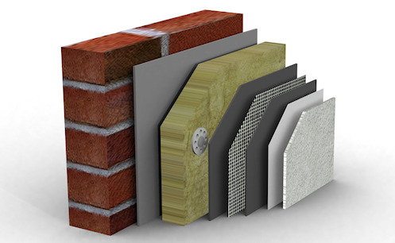
Application: Decarbonisation of the Greek building stock
Energy poverty
Evaluate the performance of conventional & smart EEMs
energy savings
return of investment
assessing economic benefits of each measure at a disaggregated (i.e., households) level
providing utilities & other potential end-users with useful insights

Slide 11
Application: Decarbonisation of the Greek building stock
Research Question
How can Demand-Flexibility be brought into the Greek residential sector without jeopardizing thermal comfort and energy services of the occupants?
Towards the Smart-Grid paradigm

Slide 12
Application: Decarbonisation of the Greek building stock
Inputs
Main model
Parameters for n buildings
n number of buildings
Weather climate data
PV installation
Building envelope
Irradiance module
Electricity Storage
-
Outputs
HVAC control settings
External temperature module
Smart thermostat
HVAC
Net building electrical demand
Σ
Occupancy profiles
Aggregated results for n buildings
Occupancy
Appliances
Activity profiles
Wholesale Electricity Market
Control strategies
Thermal comfort
Demand-Response

Slide 13
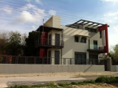
Application: Decarbonisation of the Greek building stock
Scenario Analysis
Business-As-Usual (“SC1”)
Single Family House
Pre 1980
Reference Floor Area: 162m²
Single Family House
Post 2010
Reference Floor Area: 255m²
School-aged child
(6-11 years old)
Adolescent
(12-18 years old)
Simulation period: 1/1–31/12 2020
Greek nuclear (conjugal) family: 2 working parents & 2 children

Slide 14
Application: Decarbonisation of the Greek building stock
Scenario Analysis
Enabling next-generation of smart energy services valorizing EE and flexibility at demand-side as energy resource (“SC2”)
Single Family House
Pre 1980
Reference Floor Area: 162m²
School-aged child
(6-11 years old)
Adolescent
(12-18 years old)
Single Family House
Post 2010
Reference Floor Area: 255m²
Simulation period: 1/1–31/12 2020
Greek nuclear (conjugal) family: 2 working parents & 2 children

Slide 15
Application: Decarbonisation of the Greek building stock
Scenario Analysis
Investment in smart infrastructure that enables demand-flexibility…
DR Signals
School-aged child
(6-11 years old)
Adolescent
(12-18 years old)
Energy Supplier
…allowing occupants to comply with DR signals, while operational & comfort constraints are not violated

Slide 16
Application: Decarbonisation of the Greek building stock
Climatic Zone B
city of Athens
Boundary Conditions
Weather Data
Single Family House
Post 2010
Single Family House
Pre 1980

Slide 17
Application: Decarbonisation of the Greek building stock
Building Typologies
Single Family House
Pre 1980
Climatic Zone B
city of Athens
TABULA
webtool
Single Family House
Post 2010

Slide 18
Application: Decarbonisation of the Greek building stock
Thermal Comfort
Applicability of the thermal comfort categories of the EN 15251 standard
 | Thermal state of the body as a whole
Category | PPD (%) | PMV | Explanation
I | <6 | -0.2 < PMV < +0.2 | High level of expectation
II | <10 | -0.5 < PMV < +0.5 | Normal level of expectation
III | <15 | -0.7 < PMV < +0.7 | Acceptable, moderate level of expectation
IV
(a) | <20 | -1 < PMV < +1 | Marginal level of expectation
(b) | >20 | PMV < -1 or PMV > +1 | Inacceptable level of expectation

Slide 19
Application: Decarbonisation of the Greek building stock
Demand-Response
A central planner attempts to
maximize flexibility value by issuing DR signals
“real-world” approach
Wholesale market
Input
Environment
Output
E
3-variable vector $S= \left[s_{1},s_{2},s_{3}\right]$
$s_{1}$ - System Marginal Price (SMP)
$s_{2}$ - demand forecast
$s_{3}$ - actual demand
Reward
Best Action
Optimal mix of DR signals
D
State
Algorithm
Agent
Initialization according to 2015 historical data
Reinforcement Learning (RL)
Central planner

Slide 20
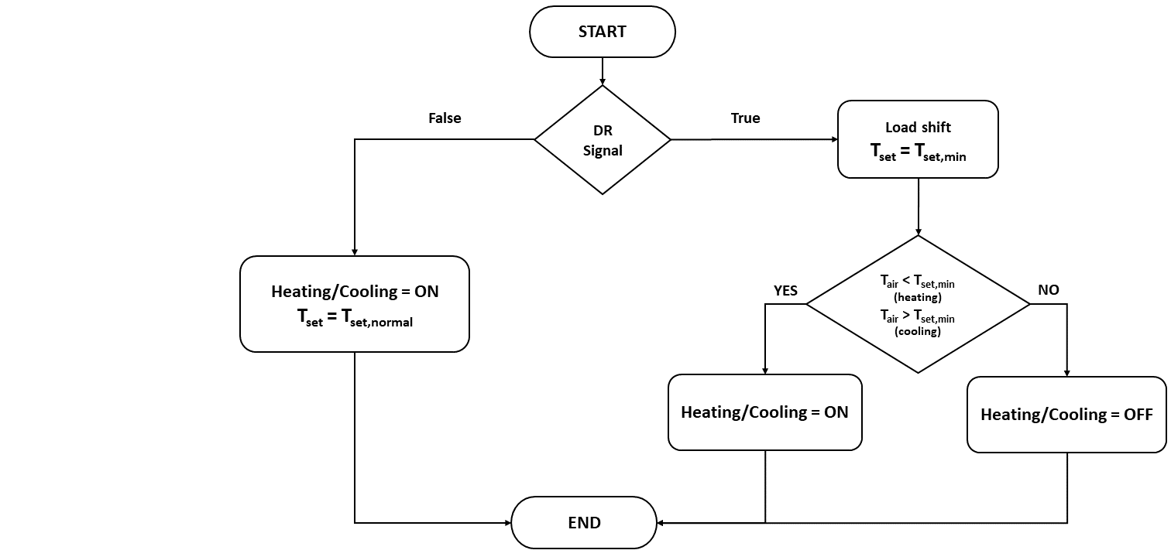
Application: Decarbonisation of the Greek building stock
DR Control Strategy

Slide 21
Application: Decarbonisation of the Greek building stock
Results
Thermal comfort categories of the EN 15251 standard
Acceptable Ranges of Indoor Temperature Setpoints
PMV
Temperature (ºC)

Slide 22
Application: Decarbonisation of the Greek building stock
Results
Acceptable Ranges of Indoor Temperature Setpoints
 | Temperature ranges (ºC)
 |  | Period 1 (Ap-My) | Period 1 (Oc-No) | Period 2 | Period 3
I |  | 24.57-25.38 | 24.31-25.09 | 24.77-25.51 | 22.95-24.09
II |  | 24.05-25.81 | 23.72-25.68 | 24.22-26.12 | 22.81-24.64
III |  | 23.69-26.16 | 23.33-26.07 | 23.85-26.43 | 22.45-25.01
IV(a) |  | 21.09-28.08 | 22.74-26.66 | 23.30-26.98 | 21.90-25.56
Single Family House
Pre 1980
(I). Period 1 (mild weather): April, May, October, and November,
(II). Period 2 (hot weather): June to September,
(III). Period 3 (cold weather): December to March
Single Family House
Post 2010
Temperature ranges (ºC)
 | Period 1 (Ap-My) | Period 1 (Oc-No) | Period 2 | Period 3
I | 22.35-23.18 | 23.69-24.48 | 24.44-25.24 | 21.86-22.67
II | 21.72-23.81 | 23.10-25.07 | 23.85-25.83 | 21.25-23.29
III | 21.31-24.22 | 22.70-25.47 | 23.44-26.23 | 20.84-23.69
IV(a) | 20.68-24.85 | 22.11-26.06 | 22.85-26.83 | 20.23-24.31

Slide 23
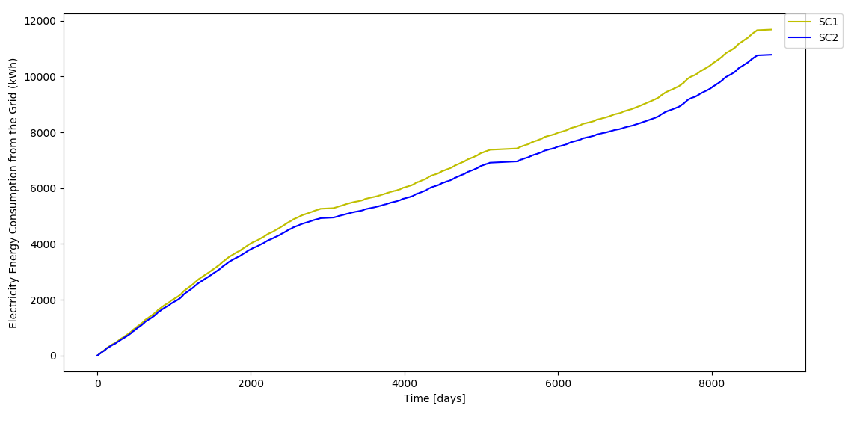
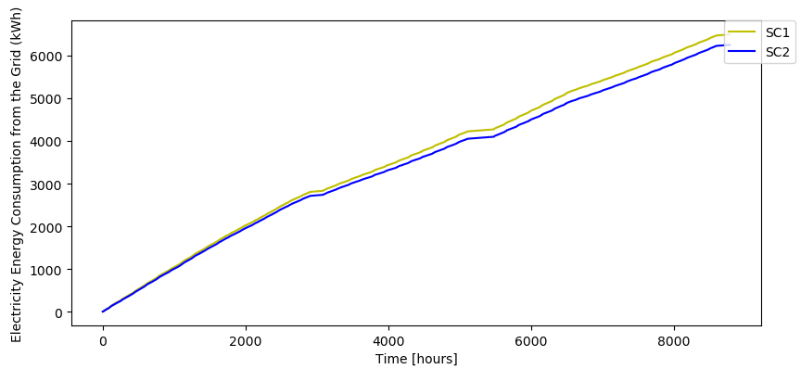
Application: Decarbonisation of the Greek building stock
Results
Impact of Demand-Response Actions on Thermal Comfort and Energy Cost
Appliances
Energy Consumption
(SC1-SC2)
HVAC system
Single Family House
Pre 1980
Single Family House
Post 2010

Slide 24
Application: Decarbonisation of the Greek building stock
Results
Impact of Demand-Response Actions on Thermal Comfort and Energy Cost
No losses due to energy shifting during dynamic DR signals
No sacrifices of energy needs & services
Single Family House
Pre 1980
Single Family House
Post 2010

Slide 25
Application: Decarbonisation of the Greek building stock
Results
Impact of Demand-Response Actions on Thermal Comfort and Energy Cost
Thermal comfort at acceptable levels
maximum discomfort of 20% according to the Fanger theory
– PMV value in [-1.1]
Single Family House
Pre 1980
Single Family House
Post 2010

Slide 26
Application: Decarbonisation of the Greek building stock
Results
Single Family House Pre 1980
900 kWh
Energy savings due to small automated temperature setpoint
adjustments during dynamic DR signals

Slide 27
Application: Decarbonisation of the Greek building stock
Results
Single Family House Post 2010
250 kWh
Energy savings due to small automated temperature setpoint
adjustments during dynamic DR signals

Slide 28
Application: Decarbonisation of the Greek building stock
In Summary
Savings
Single Family House
Pre 1980
Single Family House
Post 2010
$$0.95 \frac{kWh}{m^{2}}$$
$$5.56 \frac{kWh}{m^{2}}$$
$$1.23 \frac{€}{m^{2}}$$
$$0.19 \frac{€}{m^{2}}$$
Consumers
The RL optimal policy suggests a 16% raise in the retailer’s margin (compared to a no DR regime)
~ €1 billion at a National scale
Opportunity for extra revenue from the promotion of the full electrification of heating/cooling in the residential sector
Energy Supplier

Slide 29
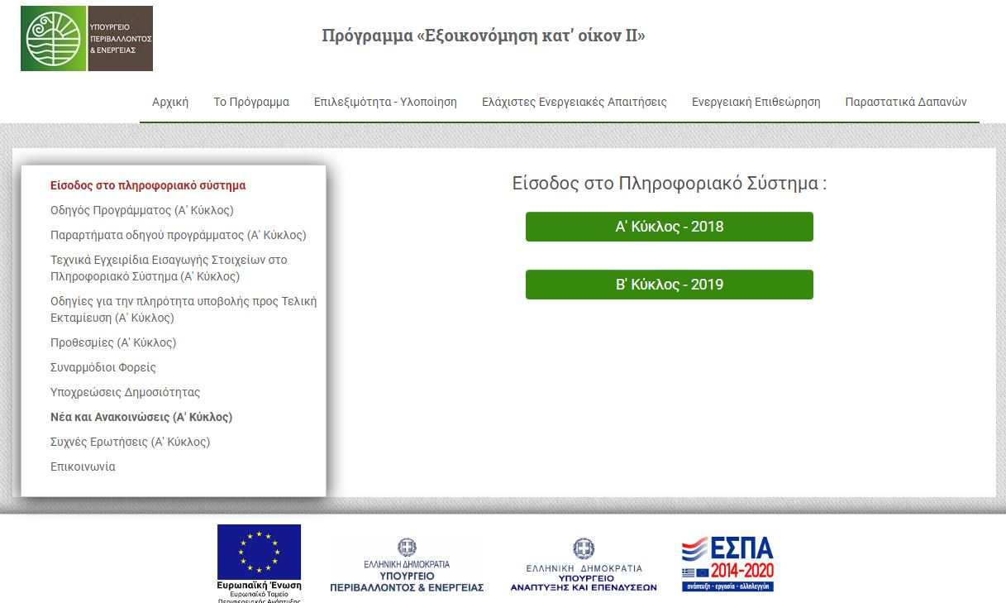
Application: Decarbonisation of the Greek building stock
Additional Energy Efficiency (EE) Scenarios
“Saving Energy at Home II”
Programme

Slide 30
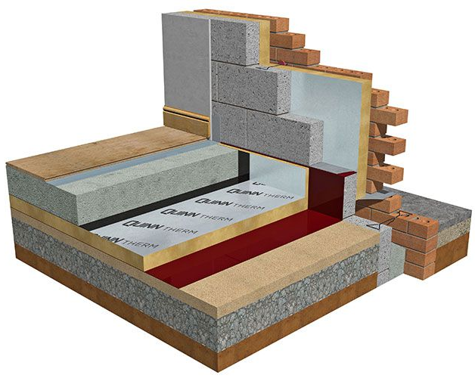
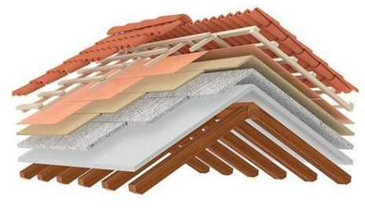
Application: Decarbonisation of the Greek building stock
Additional Energy Efficiency (EE) Scenarios
EE Measure 2
EE Measure 3
Floor: Insulation - Slab on grade/ unheated space
Exterior Walls:
Insulation for NZEB scenario
EE Measure 4
Roof: Insulation - Tilted reinforced concrete slab with ceramic tile

Slide 31
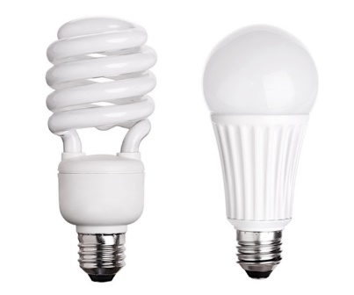
Application: Decarbonisation of the Greek building stock
Additional Energy Efficiency (EE) Scenarios
EE Measure 5
EE Measure 6
Replace incandescent or halogen bulbs with LED bulbs
EE Scenario 7
Windows: Double Pane windows - Low-energy synthetic frame with thermal break
Small-scale PV installation (1 kWp)
under the current Net-Metering policy scheme

Slide 32
Application: Decarbonisation of the Greek building stock
$$Levelised Cost of Saved$$
$$Energy (LCSE)$$
$$\frac{€}{kWh}$$
$$LCSE=\frac{C∙Capital Recovery Factor}{D}$$
$$Capital Recovery Factor \left(CRF\right)= \frac{A∙ {(1+A)}^{B}}{{(1+A)}^{B} −1}$$
where:
A: Discount Rate
B: Estimated Measure Life in Years
C: Total Investment Cost
D: Total kWh of Saved Energy

Slide 33
Application: Decarbonisation of the Greek building stock
Measure Cost Data
EE Measure 2
EE Measure 3
 | Pre 1980 | Post 2010
A | 3% *
B | 40 years *
C | 4,080 € * | 7,040 € *
D | 1,576.50 kWh ** | 211.02 kWh **
 | Pre 1980 | Post 2010
A | 3% *
B | 40 years *
C | 3,060 € * | 6,000 € *
D | 764.30 kWh ** | 169.06 kWh **
EE Measure 4
EE Measure 5
 | Pre 1980 | Post 2010
A | 3% *
B | 40 years *
C | 3,300 € * | 5,840 € *
D | 4,320.77 kWh ** | 320.79 kWh **
 | Pre 1980 | Post 2010
A | 3% *
B | 25 years *
C | 3,450 € * | 3,960 € *
D | 805.20 kWh ** | 323.68 kWh **

Slide 34
Application: Decarbonisation of the Greek building stock
Measure Cost Data
EE Measure 6
EE Measure 7
 | Pre 1980 | Post 2010
A | 3% *
B | 3 years *
C | 20 € *
D | 1,288.23 kWh **
 | Pre 1980 | Post 2010
A | 3% *
B | 20 years *
C | 1,000 € *
D | 2,143.37 kWh **
* Indicative Measure Cost Data, as obtained from the scientific literature and technical reports
** Energy Savings as derived from the model

Slide 35
Application: Decarbonisation of the Greek building stock
Relationship between LCSE - Energy Savings
Single Family House – Pre 1980
Break-even
0.203$\frac{€}{kWhe}$

Slide 36
Application: Decarbonisation of the Greek building stock
Relationship between LCSE - Energy Savings
Single Family House – Post 2010
Break-even
0.203$\frac{€}{kWhe}$
$$LCSE >1$$

Slide 37
Application: Decarbonisation of the Greek building stock
Conclusions
Attractive EEMs
Single Family House
Pre 1980
EEM 1
EEM 4
EEM 2
EEM 3
Constructed before the Greek Regulation for Thermal Insulation in Buildings
EEM 6
EEM 7

Slide 38
Application: Decarbonisation of the Greek building stock
Conclusions
Attractive EEMs
Single Family House
Post 2010
EEM 1
EEM 6
Constructed according to the Greek Energy Performance of Buildings Directive (KENAK)
EEM 7

Slide 39
Application: Decarbonisation of the Greek building stock
Conclusions
Smart EEMs seem equally/more attractive than traditional measures for both cases
Increased demand-flexibility can be brought to the Greek building sector without:
I. Significant changes in the current market design,
II. Consumers sacrificing thermal comfort & energy services
Synergistic co-operation between the power supplier & consumers, could lead to significant cost reductions & energy savings
“Game-changer” business models that capture new value on the supply side by coupling it to the demand side

Slide 40
Further Research…
Energy poverty
Evaluate the performance of conventional & smart EEMs
energy savings
return of investment
inclusion of socioeconomic & demographic factors
customer profiles
particularities of energy poor households
selection of
tailor-made
EEMs
maximum
impact

Slide 41
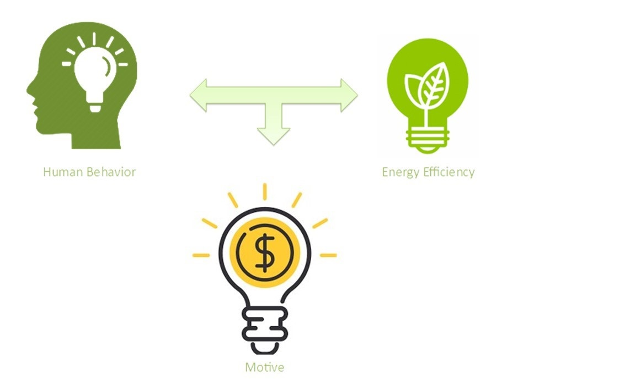
Further Research…
Energy Currency
Human behavior
Energy efficiency
Computational Monetary Framework
Incentives
financial benefits from obtaining energy saving practices
structured policy framework to motivate people regulating energy consumption

Slide 42
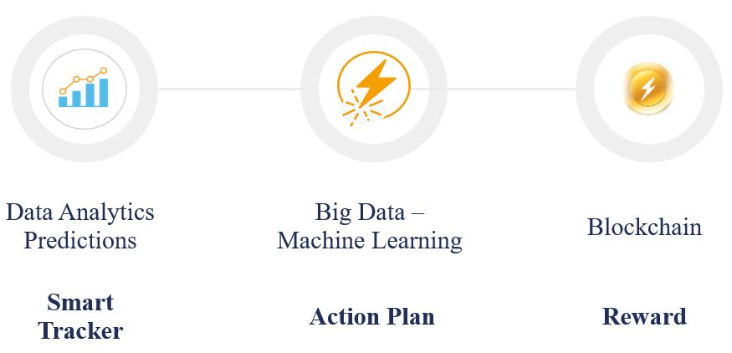
Further Research…
Energy Currency
Human behavior
Energy efficiency
Peer-to-Peer” (P2P) energy trading
Incentives
Further Research
Sharing economy

Slide 43
Next Steps Forward…
Supporting efforts around Europe towards open modeling:
scientific reproducibility
public transparency
open source development
documentation
datasets
source code
open licenses
publicly available through existing channels

Slide 44
Business Models (BMs) to explore benefits of self-consumption & demand-flexibility in the power market
A
A central planner attempts to maximize flexibility value by issuing DR signals
Evaluate what should be considered a realistic response under different DR signals
For a given flexibility level, quantify the monetary value when brought to market
Given the monetary value, quantify the total value of different technology combinations
Given the value for consumers, derive pathways for technology adoption
E
B
D
C

Slide 45
For more information…
TEESlab, the energy modelling, strategy and policy analysis laboratory of University of Piraeus (UNIPI)
Find more about us…
Visit our Website:
https://teeslab.unipi.gr/
Contact us by e-mail:
teeslab@unipi.gr
Find us in LinkedIn:
www.linkedin.com/groups/12070918/

Slide 46
Thank you !
Alexandros Flamos aflamos@unipi.gr

